Slide 1
Forecasting Analytics
Session 1

Slide 2
Need for forecasting
Why forecast, when you would know the outcome eventually?
Early knowledge is the key, even if that knowledge is imperfect
For setting production schedules, one needs to forecast sales
For staffing of call centers, a company needs to forecast the demand for service

Slide 3
Types of forecast
A forecast can be
Short term or long term
In a micro or macro scale
Qualitative or quantitative
Based on data or judgement
Meant for projecting
A single number (Point forecast)
A range of numbers (Interval forecast)
A probability density function (Density forecast)

Slide 4
Forecasting steps
Problem formulation and data collection
Data manipulation and cleaning
Model building and evaluation
Model implementation to generate forecast
Forecast evaluation

Slide 5
Considerations for choosing a forecasting method
Purpose of forecast
Available data
Type of forecast
Time needed/available
Cost involved

Slide 6
Key issues in managing a forecasting process
Why is the forecast needed?
Who will use the forecast, for what purpose?
What level of detail/aggregation is needed?
What data are available?
What will the forecast cost?
How accurate is the forecast expected to be?
Will the forecast be available is time?
Does the forecaster understand the need of the organization?
Is there a feedback process to evaluate the forecast and adjust the forecasting process?

Slide 7
Forecasting software
We will use
MS-Excel
Minitab
R
Other options
Other general purpose software (SAS, SPSS, STATISTICA, SYSTAT etc.)
Specialized software (Autobox, Forecast Pro, ITSM etc.)

Slide 8
Data requirement
Reliability and accuracy
Relevance
In terms of context
In terms of time horizon
Consistency of definition
Data sets used in the text are downloadable from
http://www.prenhall.com/divisions/bp/app/hanke/7/

Slide 9
Scatter diagram
Plots one variable against another
One of the simplest tools for visualization
Cost | Age
859 | 8
682 | 5
471 | 3
708 | 9
1094 | 11
224 | 2
320 | 1
651 | 8
1049 | 12
Example: Maintenance cost and Age for nine buses (Spokane Transit)
This is an example of cross-sectional data (observations collected in a single point of time)

Slide 10
Scatter plot

Slide 11
Observations
Older buses have higher cost of maintenance
There is some variation (case to case)
The rise in cost is about $ 80 per year of age
It may be possible to use ‘age’ to forecast maintenance cost
Forecast would not be a ‘certain’ prediction – there would be some error

Slide 12
Time plot
Plots a variable against time index
Appropriate for visualizing serially collected data (time series)
Brings out many useful aspects of the structure of the data
Example: Electrical usage for Washington Water Power (Quarterly data from 1980 to 1991)

Slide 13
Time plot

Slide 14
Observations
There is a cyclic trend
Maximum demand in first quarter; minimum in third quarter
There may also be a slowly increasing trend (to be examined)
Any reasonable forecast should have cyclic fluctuations
Trend (if any) need to be utilized for forecasting
Forecast would not be exact – there would be some error

Slide 15

Lag plot
Plots a variable against its own lagged sample
Brings out possible association between successive samples
Example: Monthly sale of VCRs by a music store in a year
= Number of VCRs sold in time period t
= Number of VCRs sold in time period t – k

Slide 16


Example of lagged variables: Number of VCRs sold in a month
Time | Original | Lagged one step | Lagged two steps
1 | 123
2 | 130 | 123
3 | 125 | 130 | 123
4 | 138 | 125 | 130
5 | 145 | 138 | 125
6 | 142 | 145 | 138
7 | 141 | 142 | 145
8 | 146 | 141 | 142
9 | 147 | 146 | 141
10 | 157 | 147 | 146
11 | 150 | 157 | 147
12 | 160 | 150 | 157

Slide 17
Lag plot (k = 1)

Slide 18
Observations
There is a reasonable degree of association between the original variable and the lagged one.
Value of lagged variable is known beforehand, so it is useful for prediction.
Association between original and lagged variable may be quantified through a correlation.

Slide 19

Autocorrelation
Correlation between a variable and its lagged version (one time-step or more)
= Observation in time period t
= Observation in time period t – k
= Mean of the values of the series
= Autocorrelation coefficient for k-step lag

Slide 20
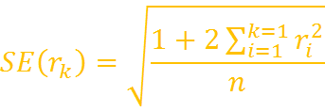

Standard error of r_{k}
The standard error is
Increases progressively with k, but eventually reaches a maximum value
If the ‘true’ autocorrelation is 0, then the estimate r_{k} should be in the interval (– 2SE(r_{k}), 2SE(r_{k})) 95% of the time.
Sometimes SE(r_{k}) is approximated by .

Slide 21
Correlogram or ACF plot
Plots the ACF or Autocorrelation function (r_{k}) against the lag (k).
Plus-and-minus two-standard errors are displayed as limits to be exceeded for statistical significance.
Reveals lagged variables that can be potentially useful for forecasting.

Slide 22
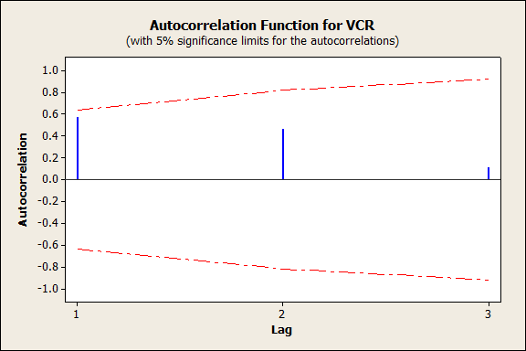
Correlogram for VCR data

Slide 23
Observations
All correlations are statistically insignificant
This could be because of small sample size

Slide 24
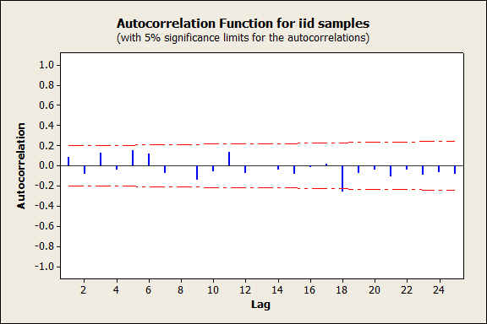
ACF plot for iid samples

Slide 25
Observations
ACF at lag 18 is statistically significant
This is clearly a case of ‘spurious correlation’, as the data are known to be uncorrelated.
We are using an imperfect tool that can go wrong 5% of the time, even if all assumptions hold.

Slide 26
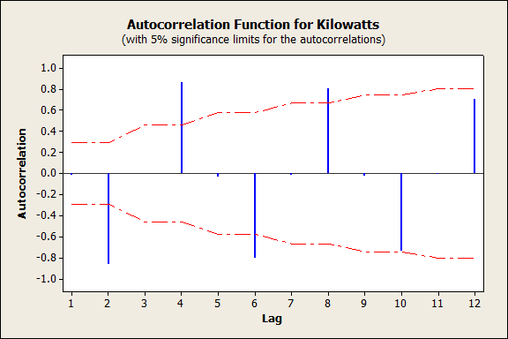
ACF plot for electricity usage data

Slide 27
Observations
Every alternate sample is large, many of them statistically significant also
ACFs at lags 4, 8, 12, etc are positive
ACF at lags 2,6,10 etc are negative
All these pick up the seasonal aspect of the data
The data may be re-examined after ‘removing’ seasonality

Slide 28
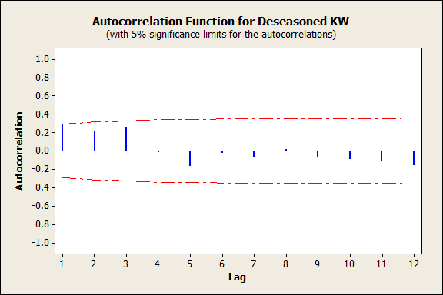
ACF of de-seasoned VCR data

Slide 29
Observations
De-seasoned series has small ACFs.
This part of the data has little forecasting value.

Slide 30
Typical questions in exploratory analysis
Is there a trend?
Is there seasonality?
Is the data random?
All the plots contain information regarding these questions

Slide 31
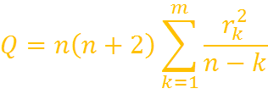
Additional tools for answering questions
For checking trend
Plot differenced series
Fit a trend function (e.g., a straight line) and examine ‘residuals’ for patterns
For checking randomness
Carry out Portmanteau test (Ljung-Box):
Q has to be compared with chi-square cut-off with m degrees of freedom.

